Slide 1
ImperiaLIST SCHOOL
SUMAN PATRA
ASSISTANT PROFESSOR
Department of History
CHANDIDAS MAHAVIDYALAYA

Slide 2
INTRODUCTION
Imperialist Writings were mostly reflecting the contemporary debate on religious faith and nationality and also their interests in enlarging the European colonies for economic exploitation.

Slide 3
Imperialist Intellectuals
Leading imperialist intellectuals of the 19th century were −
  Max Muller,
  J.S. Mill,
  William Jones,
  Hunter

Slide 4
The works of a few intellectuals have been described below −
Max Muller
Friedrich Max Muller is considered as one of the most respected Indologists of the nineteenth century. He was a German, but lived in England. On the financial support of the British East India Company, he undertook massive jobs of translation and interpretation of the Indian religious texts in English.
He attained the best achievement of getting translated a huge mass of Sanskrit texts into English, but his approach and intention were never free from the prejudice.
Muller was inspired by his religious belief and political requirements that affected his entire approach of unbiased writing and interpretation of Indian history.

Slide 5
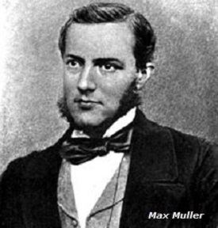

Slide 6
James Mill
Between 1806 and 1818, James Mill wrote six volumes on the history of India without ever visiting India or knowing any Indian language. He divided Indian history into three periods i.e.
  Hindu Period,
  Muslim Period, and
  British Period – (all he did without any logic and justification).
Mill presented an extremely demeaning picture of Hindu periods. He condemned every institution, idea, and action of the Hindu period and held Hindus responsible for all the ills of the country.

Slide 7
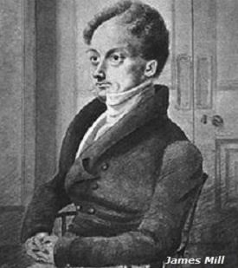

Slide 8
James Mill, his son John Stuart Mill, and his disciple Thomas Macauley played a very important role in shaping the imperialist policy in India and the future of Indian education in the core of which was the distorted history of ancient India.
V.A. Smith, an officer serving the British Government in India, prepared the text book called ‘Early History of India in 1904.’ He emphasized the role of foreigners in ancient India. Alexander's invasion accounted for almost one-third of his book.

Slide 9
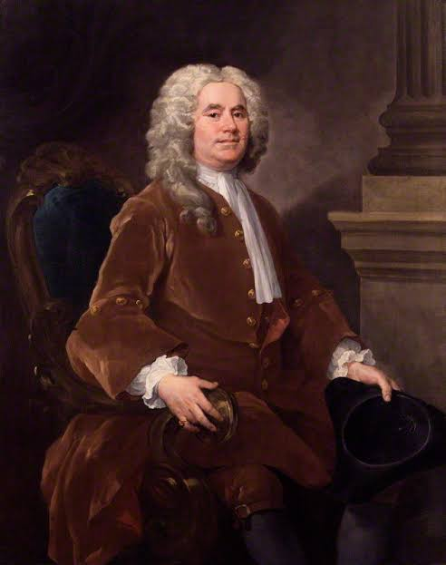
William Jones

Slide 10
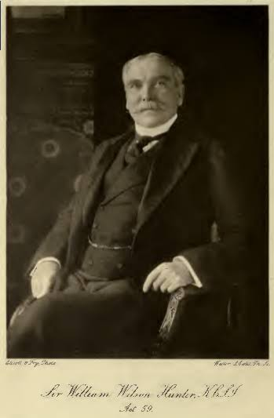
William Hunter

Slide 11
Thank You

